Slide 1
Steps to Validate
e-TDS file.

Slide 2
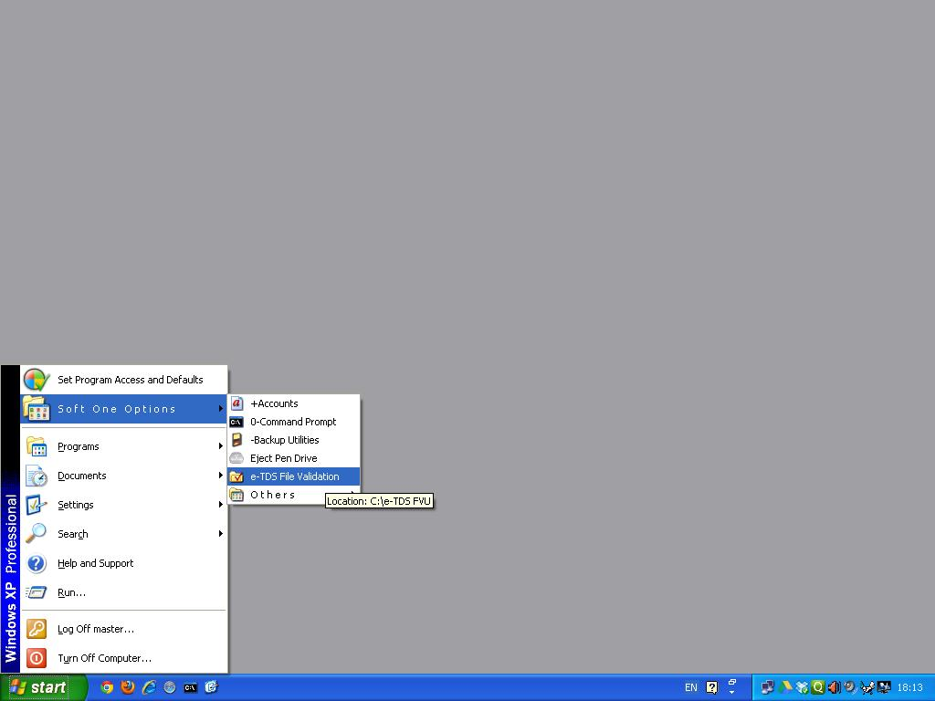
Click on e-TDS file validation utility from Start-->Financial Accounting -XP/Soft One Options

Slide 3
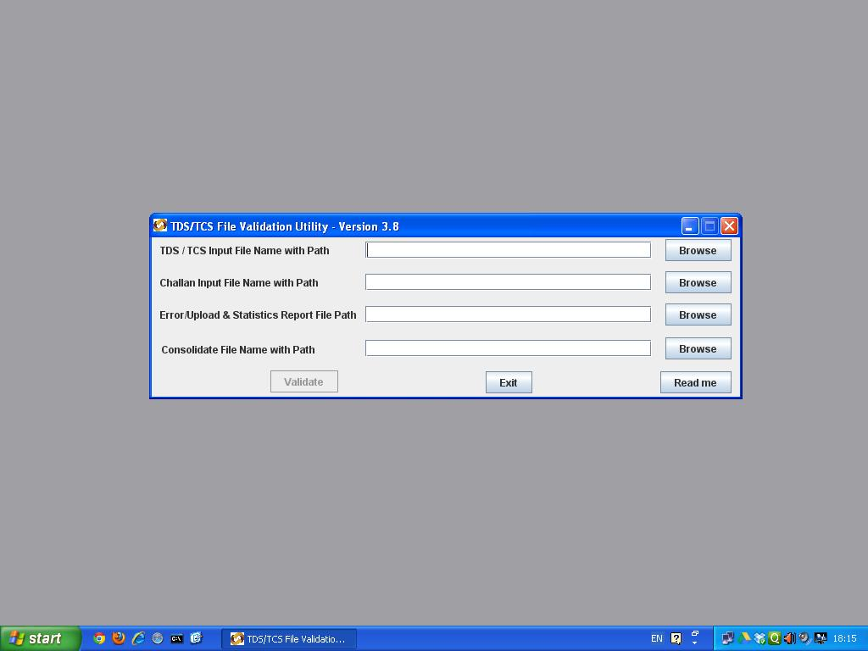
Click on the first Browse button against TDS/TCS Input File Name with Path.
Check whether the file validation utility version is the latest one.
To check, visit our website www.softone.co.in → Other Downloads.
If the Version is not the latest, download and install the same from the site.

Slide 4
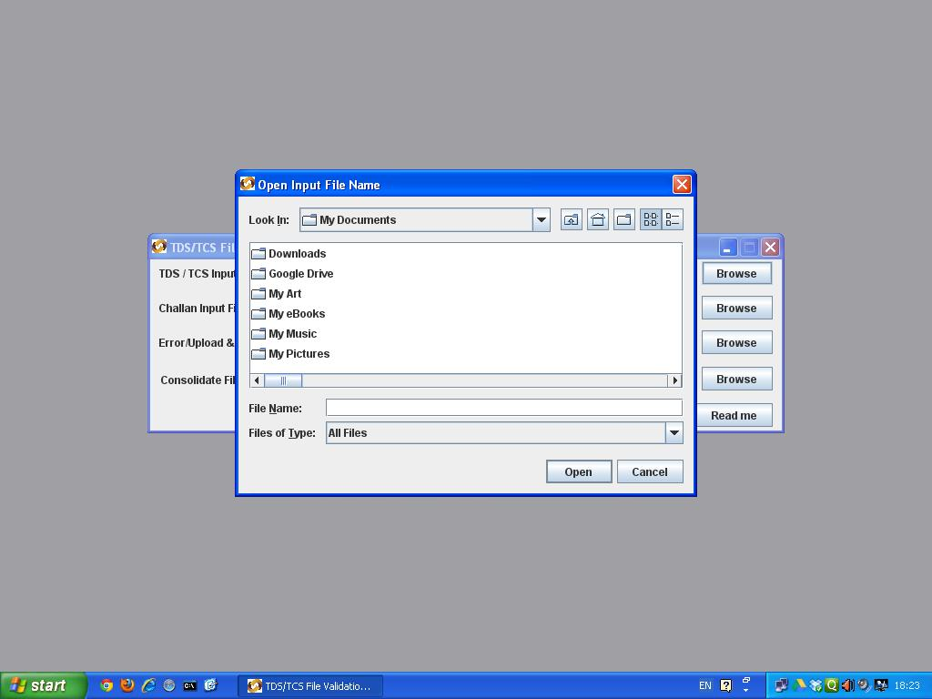
Click on My Documents or Drop down button besides it.

Slide 5
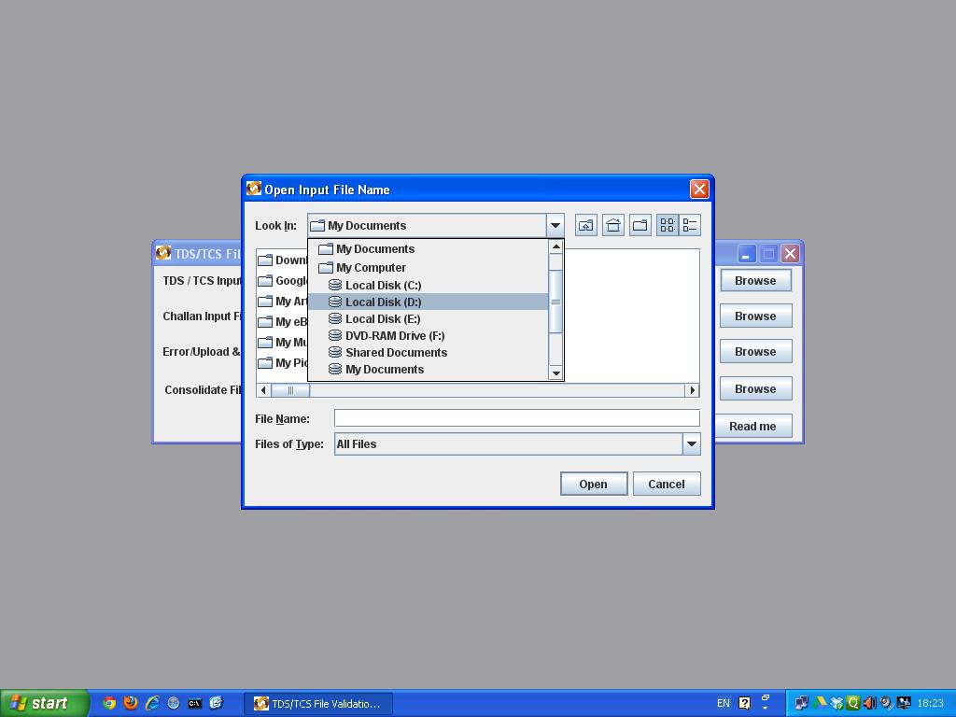
Click on Work Drive which normally will be D Drive (D:) or T Drive (T:)

Slide 6
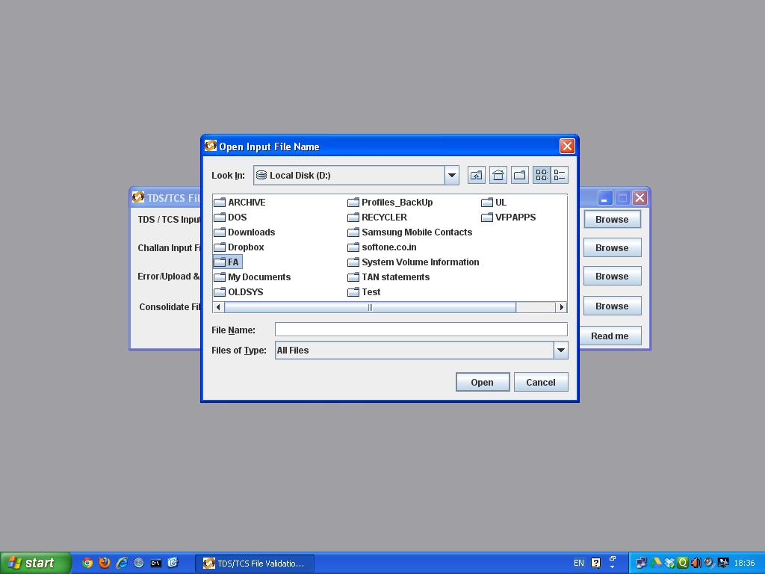
Double click on Main Folder (Normally FA)

Slide 7
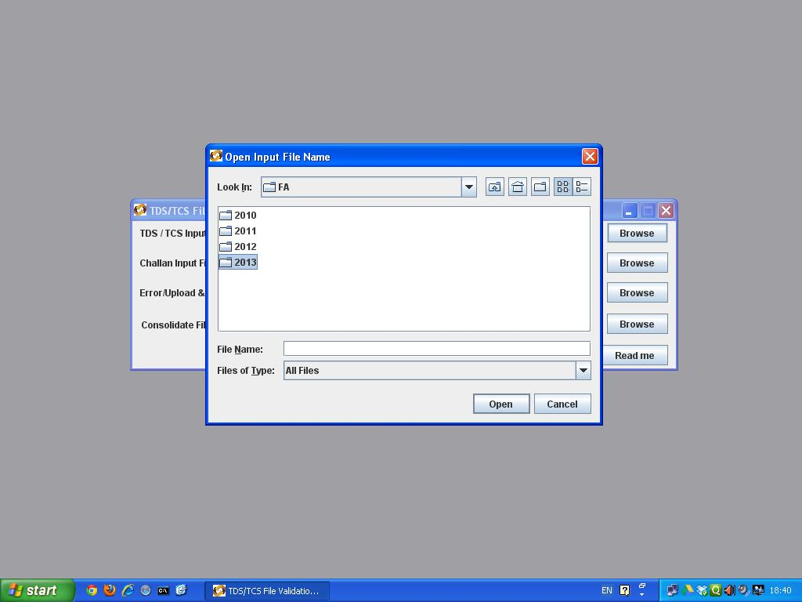
Double click on Year Folder.

Slide 8
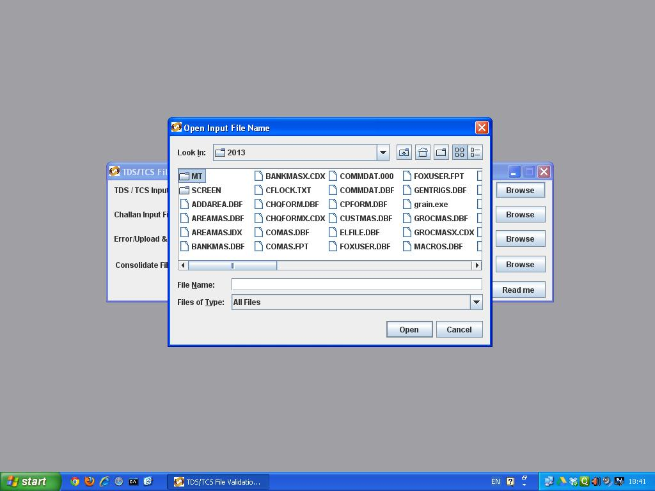
Double click on Firm Folder.

Slide 9
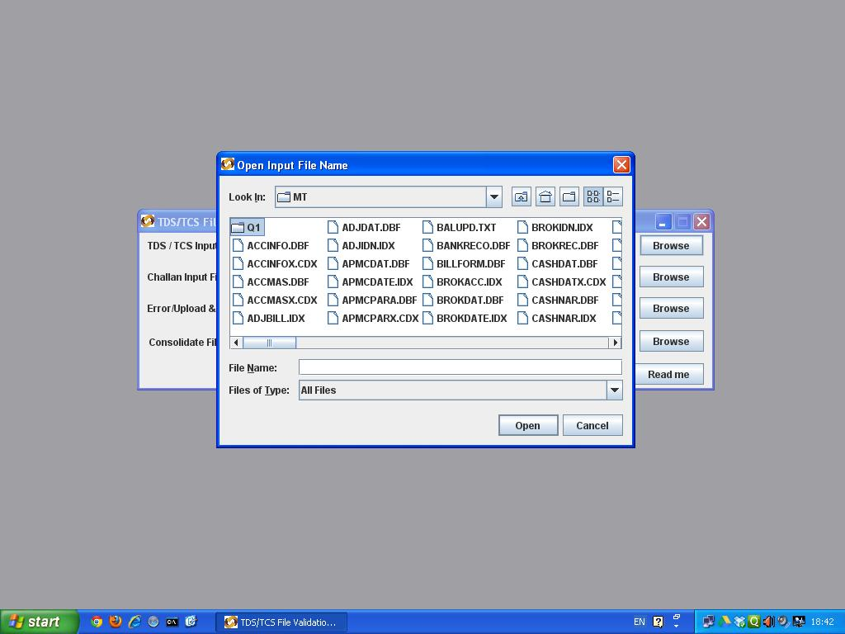
Double click on Quarter Folder.

Slide 10
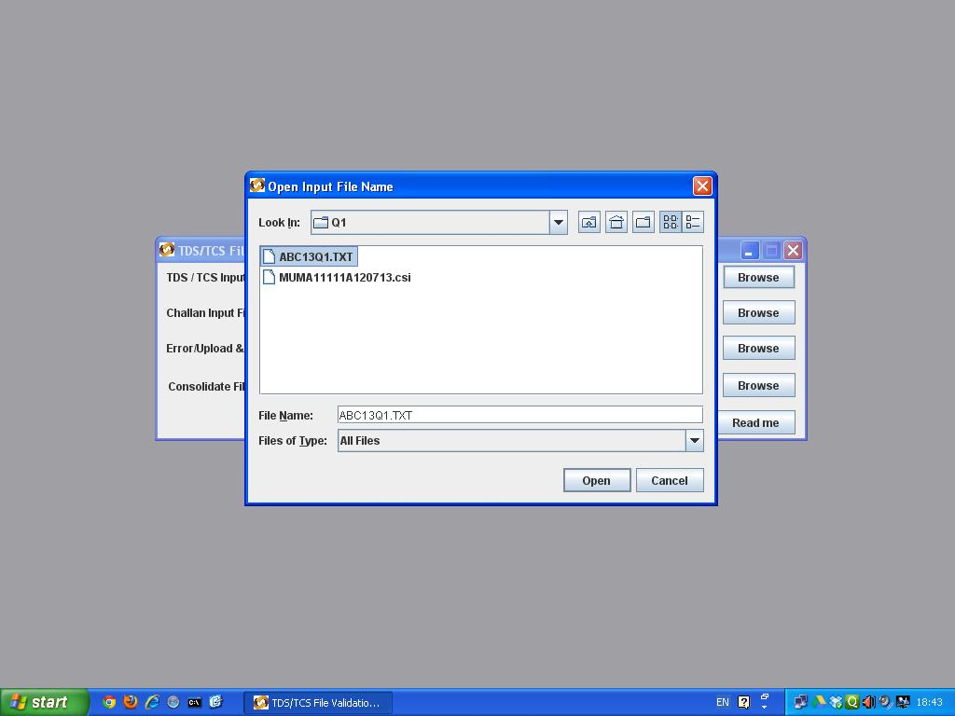
Double click on the Text File having extension as TXT. This file is generated from your financial accounting package.

Slide 11
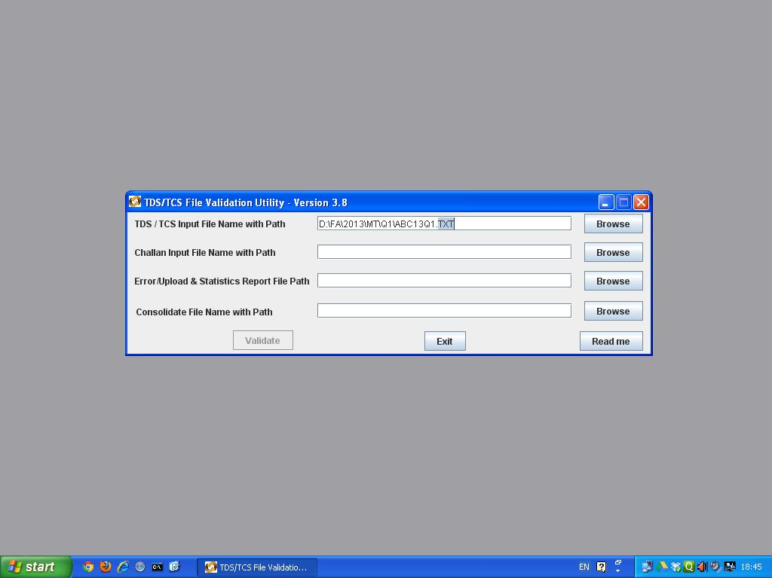
Change the File Extension to txt in lower case.

Slide 12
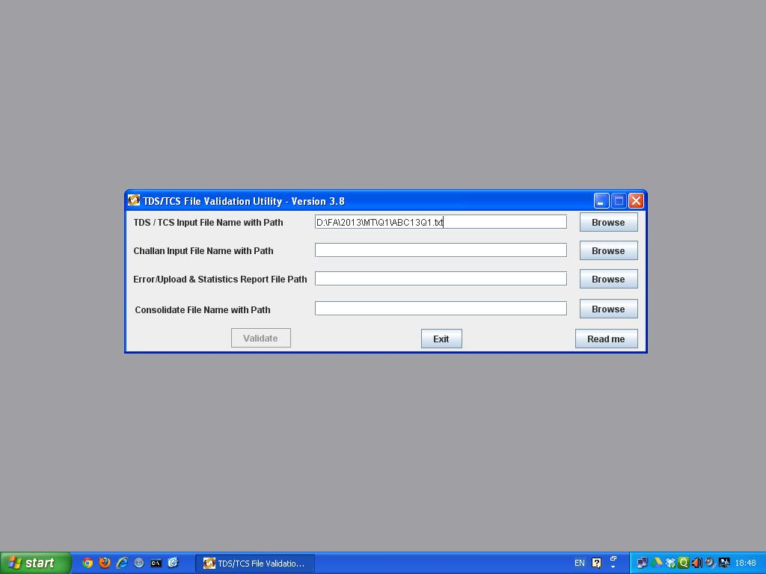
Click on Second Browse button in 2nd line against Challan Input file with Path.
This is required only if you have deducted TDS in that quarter. Otherwise leave second line blank.

Slide 13
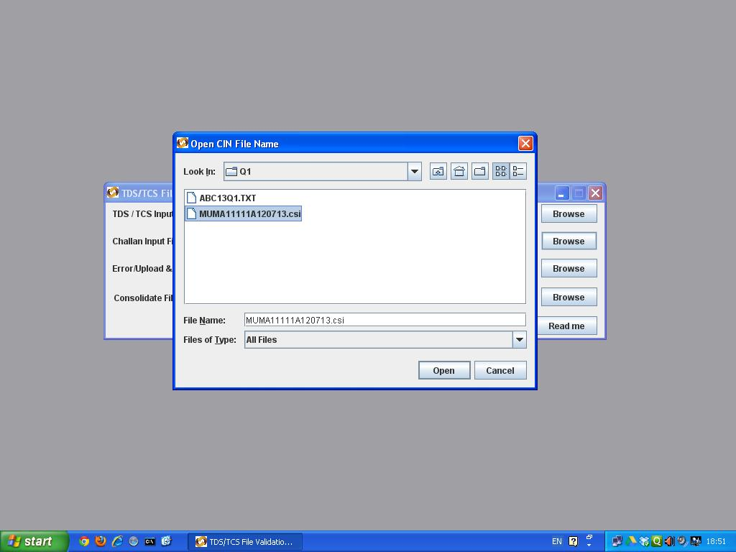
Double click on .csi file starting with your TAN No.

Slide 14
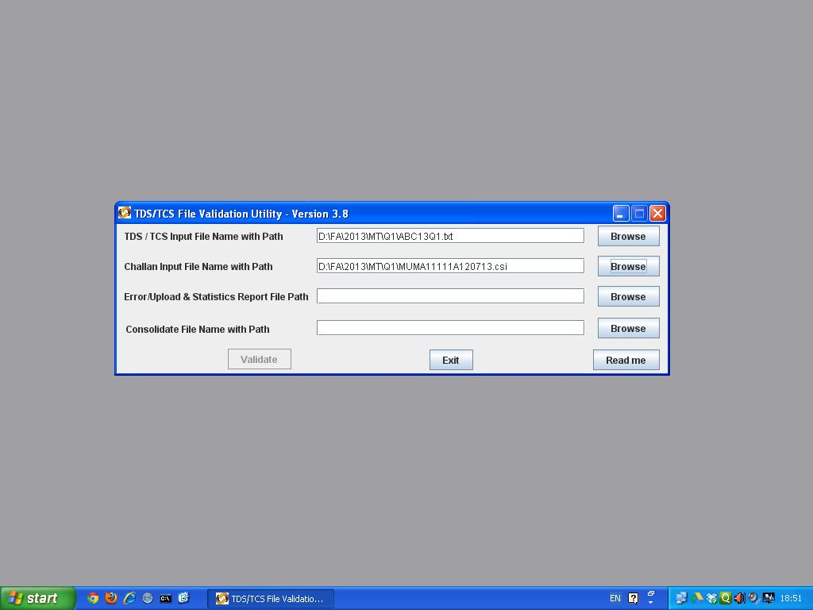
Click on third Browse button.

Slide 15
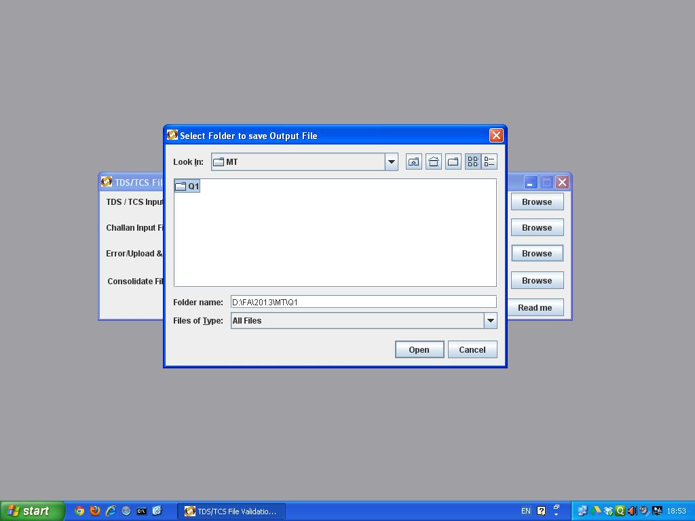
Select the Work Drive - Main Folder - Year Folder - Firm Folder - Quarter Folder.

Slide 16
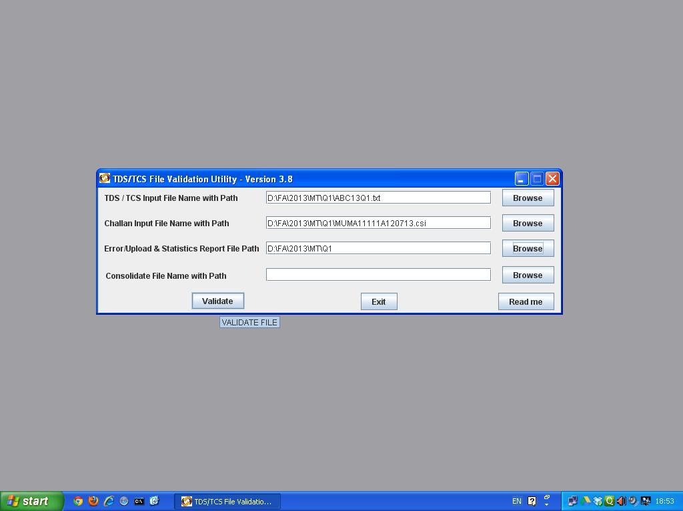
Click on validate button.

Slide 17
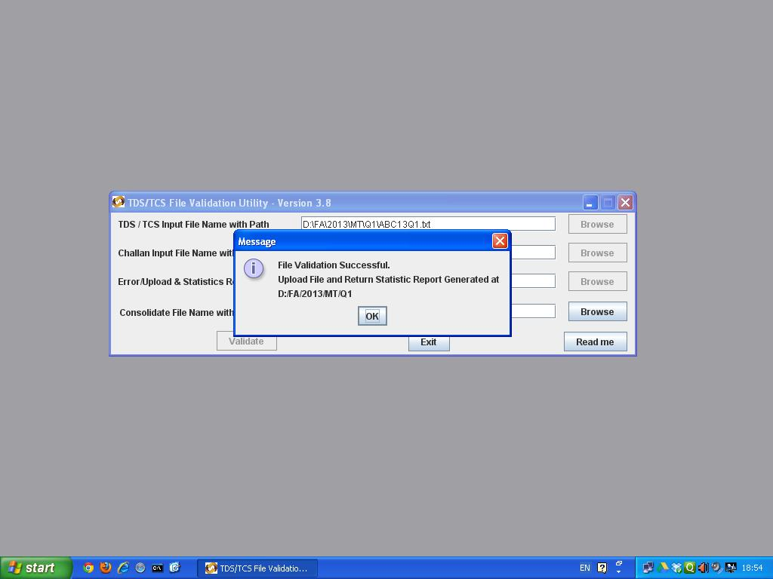
Upon successful validation, this message will appear. Click on OK button and Exit button to close the application.

Slide 18
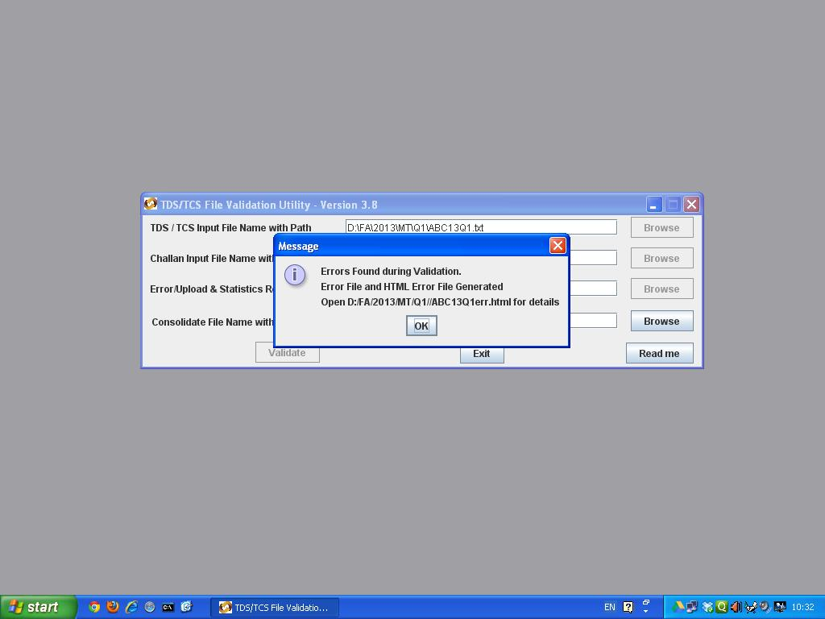
If this message appears, then there seems to be some error. Click on OK button and Exit button to close the application.

Slide 19
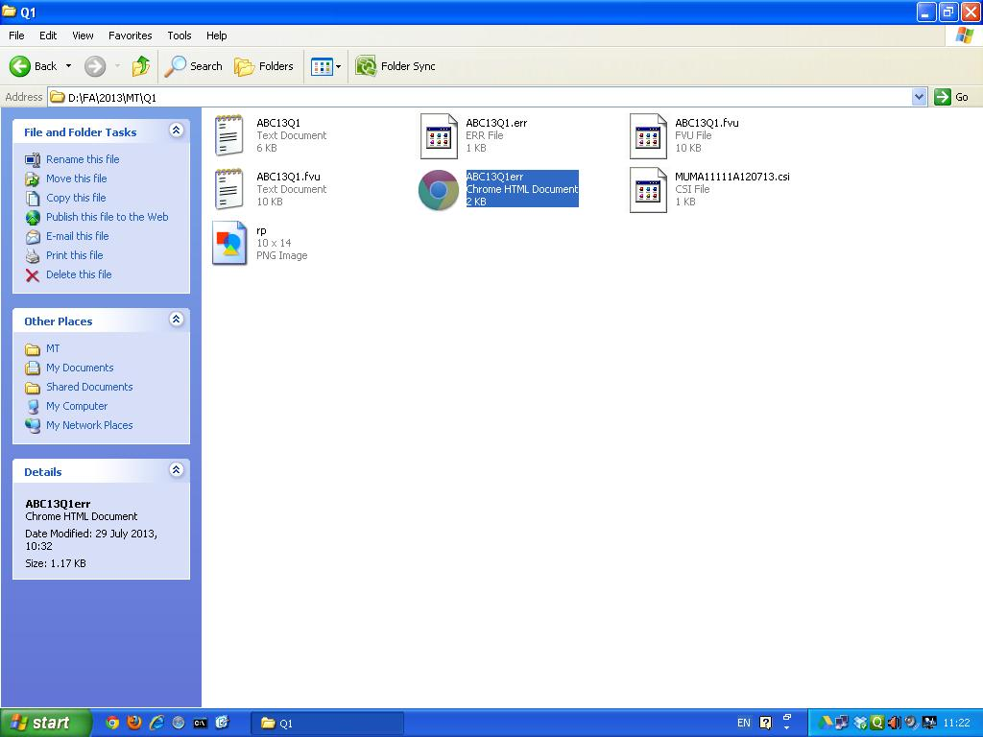
From My Computer go to Work Drive (Normally D: or T:) - Main Folder (Normally FA) - Year Folder - Firm Folder - Quarter Folder. Double click on HTML file starting with TAN No and ending with err.

Slide 20
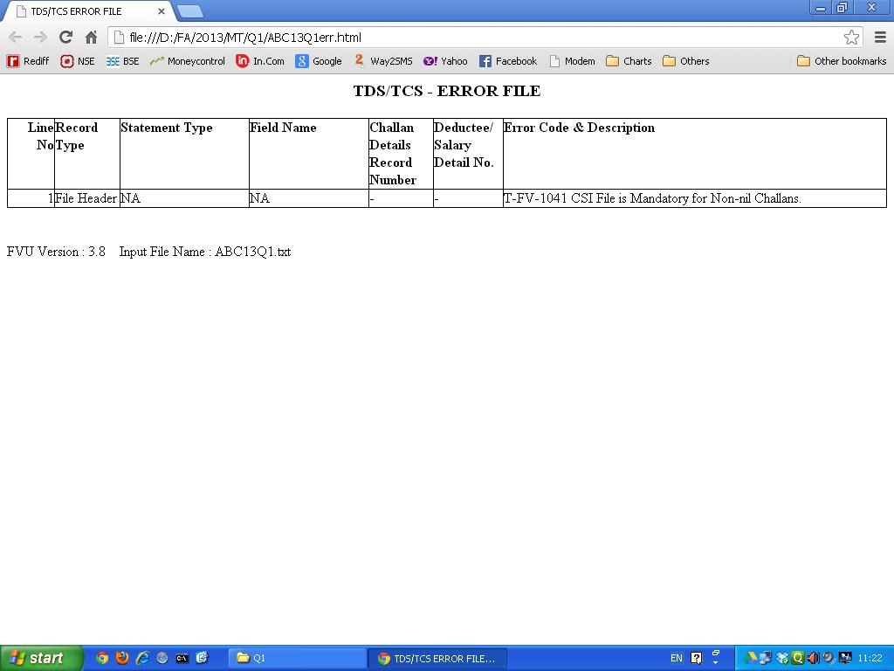
Read the error message/s and rectify them appropriately.

Slide 21
Re-generate the file from your financial accounting package, if some data is rectified such as PAN No, TAN No, Address, Tel Nos, e-mail id, deductee code, tds status, tds rate, etc. Then, re-validate successfully as shown earlier.

